Slide 1
Website Navigation and Traffic Pattern Analytics
SUBJECT: GRAPH AND WEB ANALYTICS
T. Chetan Satvik – 2320090026
K. Nikhil – 2320090025
Ch. Nikith – 2320090023
K. Vihaari - 2320090027

Slide 2
Introduction
What is Website Navigation?
The way users move between pages of a website.
Helps users find information easily.
Includes menus, links, buttons, search and breadcrumbs.
What is Traffic Pattern Analytics?
Analysis of how visitors arrive and behave on a website.
Helps identify popular pages and user journeys.
Supports data-driven website improvements.

Slide 3
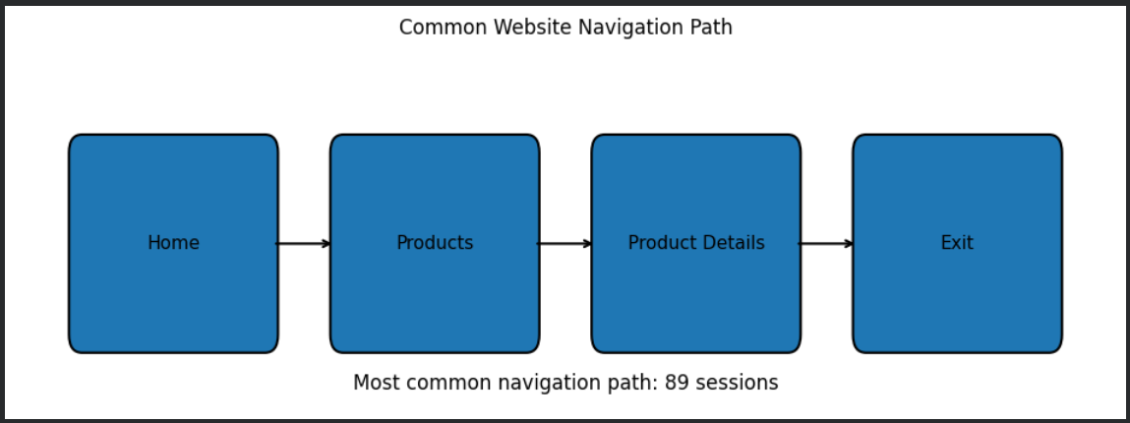
Website navigation
Common Navigation Elements
Navigation menu
Search bar
Hyperlinks
Buttons
Breadcrumbs
Footer links
Call-to-action buttons

Slide 4
Types of Website Navigation
Hierarchical Navigation
Users move from general pages to specific pages.
Example: Home → Products → Product → Details
Global Navigation
Main menu available across multiple pages.
Local Navigation
Links related to the current section.
Breadcrumb Navigation
Shows the user's current location.

Slide 5
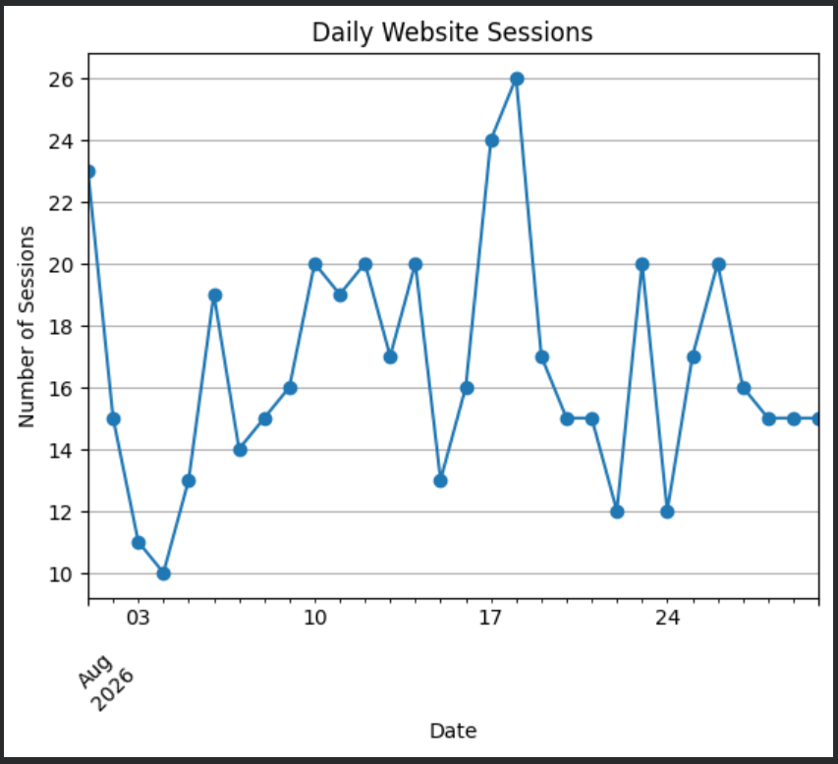
What is traffic Pattern Analytics?
Traffic Pattern Analytics = Studying visitor behaviour on a website
It analyses:
Number of visitors
Number of sessions
Pages visited
Traffic sources
Time spent
Entry and Exit pages
User journey

Slide 6
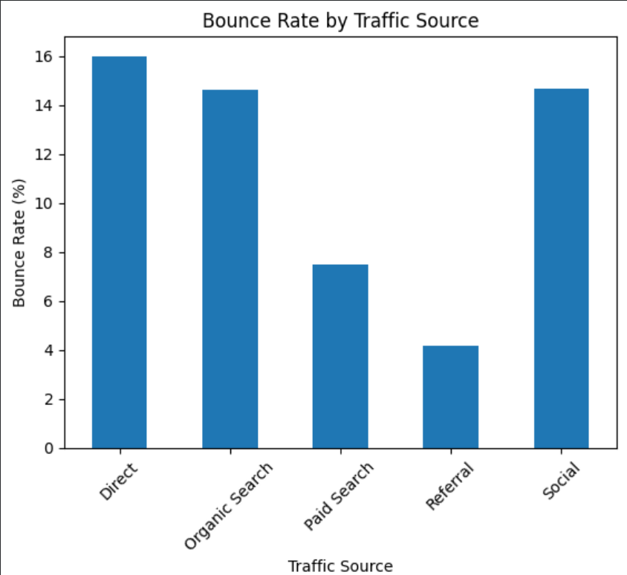
Important traffic metrics
Metric | Meaning
Users | Individual visitors
Sessions | Visits to the website
Page Views | Number of pages viewed
Engagement Time | Time users actively engage
Bounce Rate | Sessions with little or no further interaction
Exit Rate | Percentage of sessions ending on a page

Slide 7
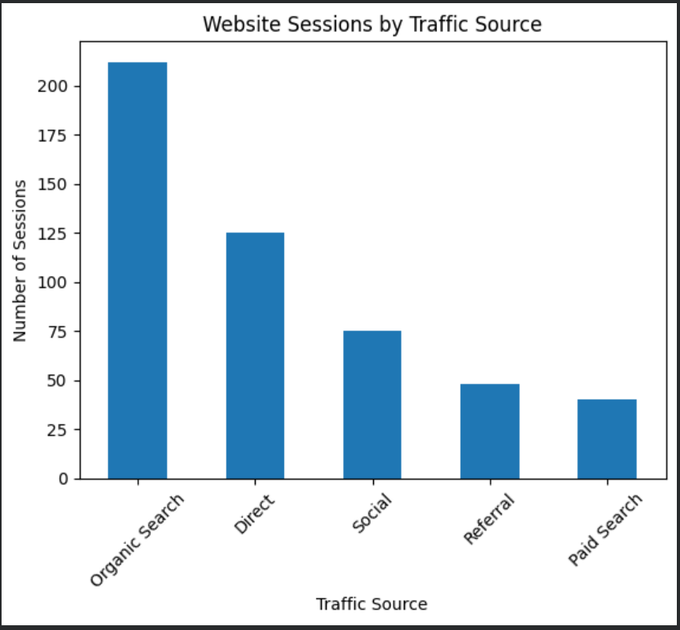
Sources of Website Traffic
Where do visitors come from?
Organic Search — Search engines
Referral — Other websites
Social — Social media
Direct — Directly entering the website
Paid Search — Online advertisements

Slide 8
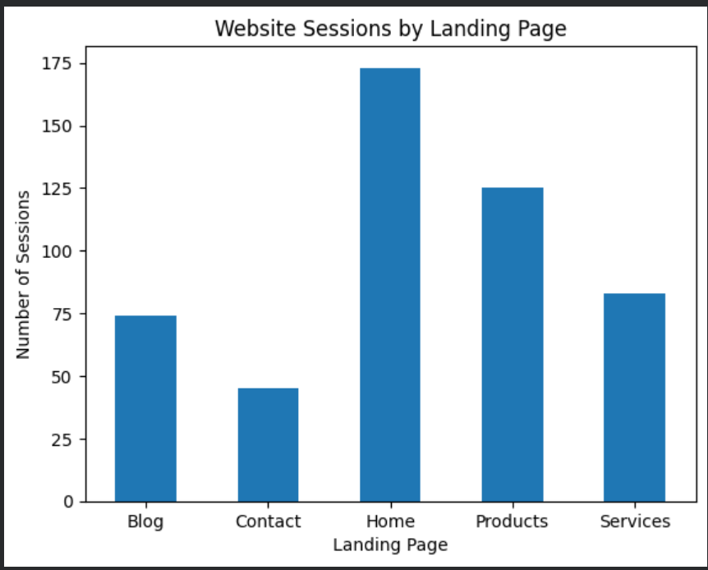
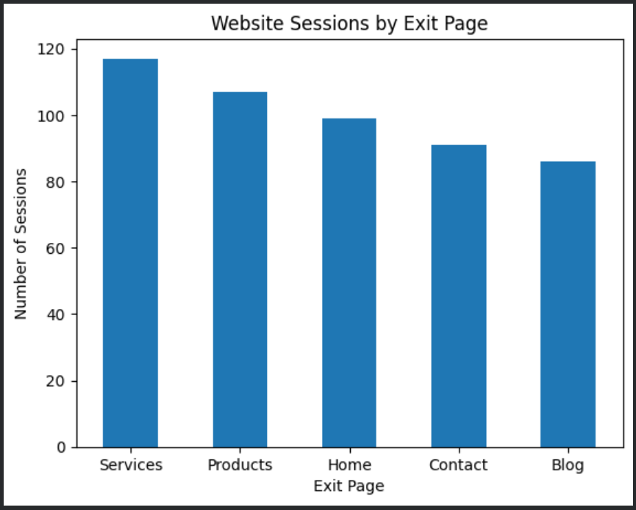
Landing page and exit page analysis
Landing pages show where sessions begin; exit pages show where sessions end

Slide 9
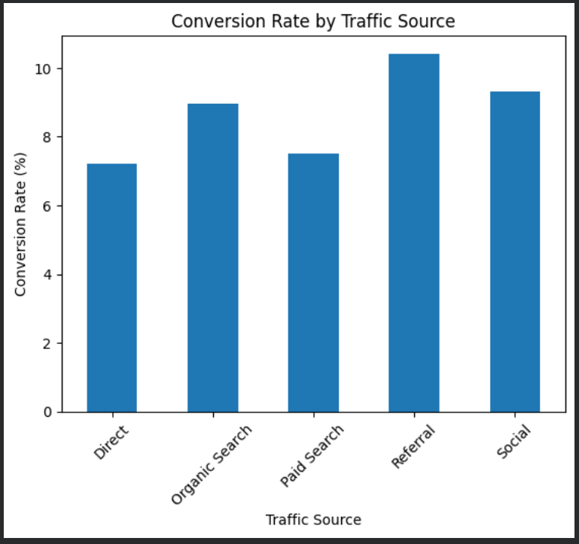
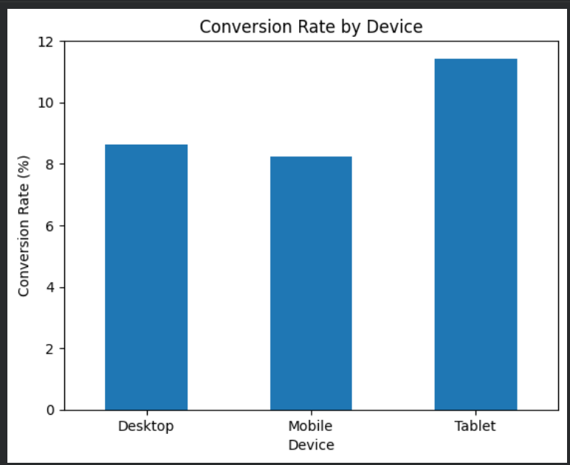
Conversion rate analysis
Conversion rate shows the percentage of sessions that result in the desired action.

Slide 10
Application and benefits
Improve website navigation
Identify popular content
Find user drop-off points
Improve user experience
Optimize marketing campaigns
Increase conversions
Understand customer behaviour
Support data-driven decisions

Slide 11
conclusion
• Website navigation helps users move through a website easily.
• Traffic analytics helps understand how visitors interact with different pages.
• Traffic patterns can be studied using sessions, bounce rate, landing pages, exit pages and conversion rate.
• Graphs make website data easier to compare and understand.
• These insights can be used to improve website design, user experience and overall performance.

